Slide 1
Introduction to Class
Source from Tony Gaddis, Barret Krupnow, Starting out with C++, 7th edition update.

Slide 2
Week 11.1
Procedural and Object-Oriented Programming

Slide 3
Procedural and Object-Oriented Programming
Procedural programming focuses on the process/actions that occur in a program
Object-Oriented programming is based on the data and the functions that operate on it. Objects are instances of ADTs that represent the data and its functions

Slide 4
Limitations of Procedural Programming
If the data structures change, many functions must also be changed
Programs that are based on complex function hierarchies are:
  difficult to understand and maintain
  difficult to modify and extend
  easy to break

Slide 5
Object-Oriented Programming
Terminology
class: like a struct (allows bundling of related variables), but variables and functions in the class can have different properties than in a struct
object: an instance of a class, in the same way that a variable can be an instance of a struct

Slide 6
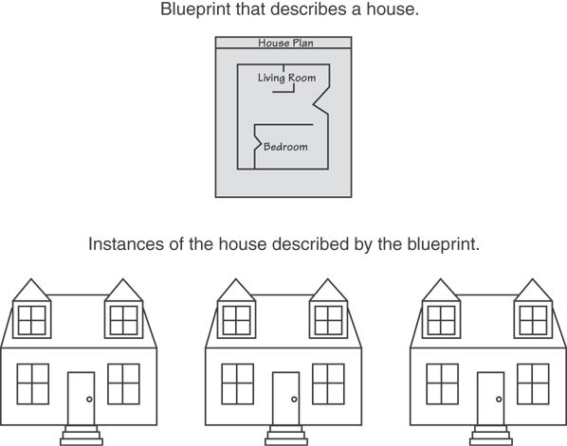
Classes and Objects
A Class is like a blueprint and objects are like houses built from the blueprint

Slide 7
Object-Oriented Programming
Terminology
attributes: members of a class
methods or behaviors: member functions of a class

Slide 8
More on Objects
data hiding: restricting access to certain members of an object
public interface: members of an object that are available outside of the object.
This allows the object to provide access to some data and functions without sharing its internal details and design, and provides some protection from data corruption

Slide 9
Week 11.2
Introduction to Classes

Slide 10
Introduction to Classes
Objects are created from a class
Format:
  class ClassName
  {
  declaration;
  declaration;
  };

Slide 11
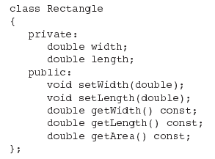
Class Example

Slide 12
Access Specifiers
Used to control access to members of the class
public: can be accessed by functions outside of the class
private: can only be called by or accessed by functions that are members of the class

Slide 13
Class Example
Private Members
Public Members

Slide 14
More on Access Specifiers
Can be listed in any order in a class
Can appear multiple times in a class
If not specified, the default is private

Slide 15

Using const With Member Functions
const appearing after the parentheses in a member function declaration specifies that the function will not change any data in the calling object.

Slide 16
Defining a Member Function
When defining a member function:
  Put prototype in class declaration
  Define function using class name and scope resolution operator (::)
    void Rectangle::setWidth(double w)
    {
    width = w;
    }

Slide 17
Accessors and Mutators
Mutator: a member function that stores a value in a private member variable, or changes its value in some way
Accessor: function that retrieves a value from a private member variable. Accessors do not change an object's data, so they should be marked const.

Slide 18
Exercise Week 11_1
Complete the following code skeleton to declare a class named Date. The class should contain variables and functions to store and retrieve a date in the form 14/4/2014
class Date{
  private:
  public:
  }
Identify the type (accessor or mutator) of the following member function to the Rectangle class
setWidth(double w);
getWidth()const;

Slide 19
Week 11.3
Defining an Instance of a Class

Slide 20
Defining an Instance of a Class
An object is an instance of a class
To define an object - defined like structure variables:
  Rectangle r;
Access members using dot operator:
  r.setWidth(5.2);
  cout << r.getWidth();
Compiler error if attempt to access private member using dot operator

Slide 21
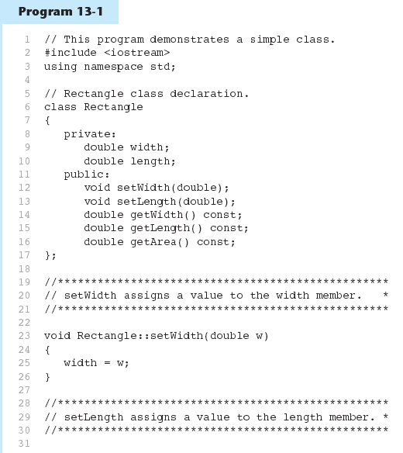
Example - Defining an Instance of a Class
Program 12-1
class
declaration

Slide 22
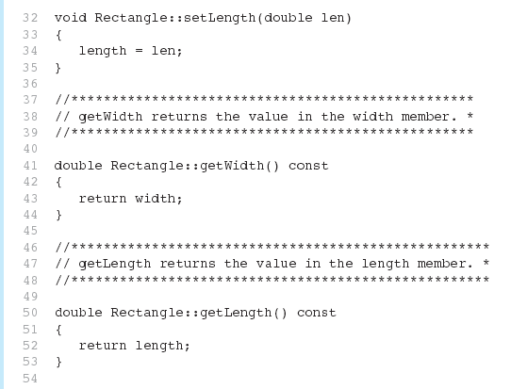
Example - Defining an Instance of a Class
Program 12-1 (Continued)

Slide 23
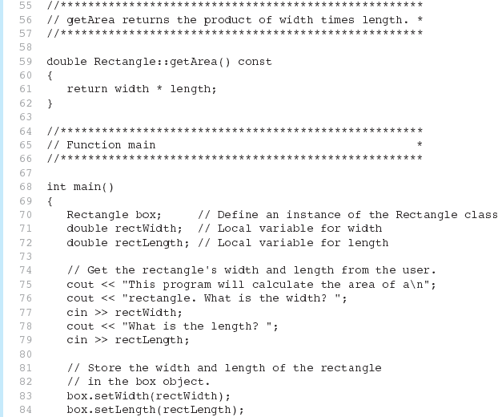
Example - Defining an Instance of a Class
Program 12-1 (Continued)
objects
definition

Slide 24
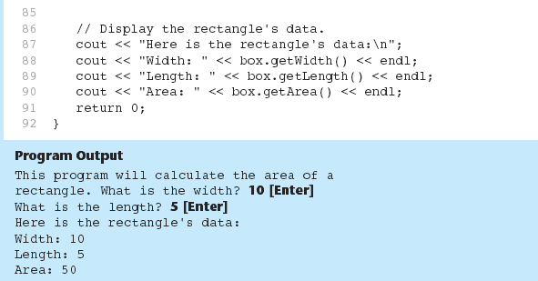
Example - Defining an Instance of a Class
Program 12-1 (Continued)

Slide 25
Avoiding Stale Data
Some data is the result of a calculation.
In the Rectangle class the area of a rectangle is calculated.
  length x width
If we were to use an area variable here in the Rectangle class, its value would be dependent on the length and the width.
If we change length or width without updating area, then area would become stale.
To avoid stale data, it is best to calculate the value of that data within a member function rather than store it in a variable.

Slide 26
Exercise Week 11_2
Refer to Exercise 1 No. 2 in Lab 9 pg. 138
Solve the problem.
Refer to Exercise 3 No. 1i - ii in Lab 9 in page 159.
Solve the problem.
How to avoid stale data in your solution?

Slide 27
Week 11.4
Why Have Private Members?

Slide 28
Why Have Private Members?
Making data members private provides data protection
Data can be accessed only through public functions
Public functions define the class’s public interface

Slide 29

How to Access Private Members?
Code outside the class must use the class's public member functions to interact with the object.

Slide 30
Exercise Week 11_3
Refer to Exercise 2 No. 2 in Lab 9 in pg. 151
Solve the problem.

Slide 31
Week 11.6
Inline Member Functions

Slide 32
Inline Member Functions
Member functions can be defined
  inline: in class declaration
  after the class declaration
Inline appropriate for short function bodies:
  int getWidth() const
  { return width; }

Slide 33
Rectangle Class with Inline Member Functions
class Rectangle
{
private:
double width;
double length;
public:
void setWidth(double);
void setLength(double);
double getWidth() const
{ return width; }
double getLength() const
{ return length; }
double getArea() const
{ return width * length; }
};
3 inline
member functions

Slide 34
Tradeoffs – Inline vs. Regular Member Functions
Regular functions – when called, compiler stores return address of call, allocates memory for local variables, etc.
Code for an inline function is copied into program in place of call – larger executable program, but no function call overhead, hence faster execution

Slide 35
Exercise Week 11_5
Refer to your solution for Exercise Week 11_2 (Exercise 3 No.1 pg. 159-160)
Solve question iii.

Slide 36
Week 11.7
Constructors

Slide 37
Constructors
Member function that is automatically called when an object is created
Purpose is to construct an object
Constructor function name is class name
Has no return type

Slide 38
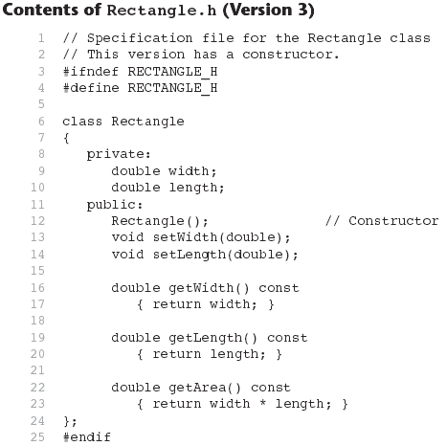
Example- Constructors
Constructor
in class definition

Slide 39
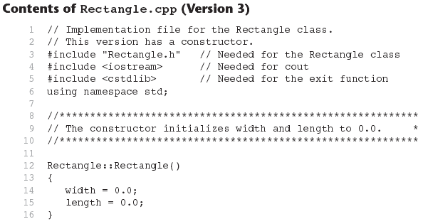
Contents of Rectangle.ccp Version3
Constructor
definition
Continues...

Slide 40
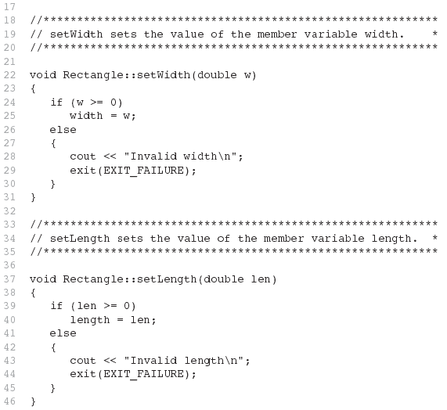
Contents of Rectangle.ccp Version3 (continued)

Slide 41
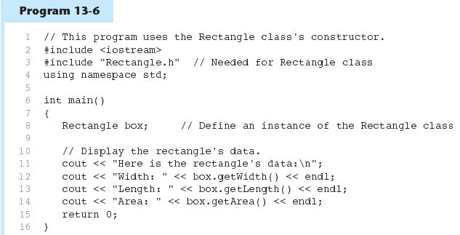
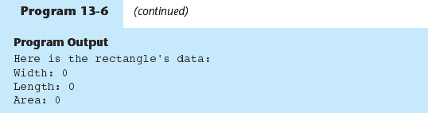
Contents of Rectangle.ccp Version3 (continued)
Program 12-6
Program 12-6 Continued

Slide 42
Default Constructors
A default constructor is a constructor that takes no arguments.
If you write a class with no constructor at all, C++ will write a default constructor for you, one that does nothing.
A simple instantiation of a class (with no arguments) calls the default constructor:
  Rectangle r;

Slide 43
Exercise Week 11_6
Refer to your solution for Exercise Week 11_5 (Exercise 3 No. 1)
Change the function to read all the 3 number to a constructor function

Slide 44
Pointer to an Object
Can define a pointer to an object:
  Rectangle *rPtr;
Can access public members via pointer:
  rPtr = &otherRectangle;
  rPtr->setLength(12.5);
  cout << rPtr->getLenght() << endl;

Slide 45
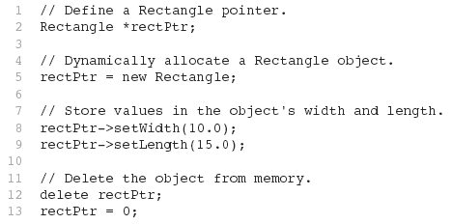
Dynamically Allocating an Object
We can also use a pointer to dynamically allocate an object.

Slide 46
Exercise Week 11_7
Refer to your solution for Exercise Week 11_6 (Exercise 3 No. 1)
Change the solution to use pointer

Slide 47
Week 11.8
Passing Arguments to Constructors

Slide 48
Passing Arguments to Constructors
To create a constructor that takes arguments:
  indicate parameters in prototype:
  Rectangle(double, double);
  Use parameters in the definition:
  Rectangle::Rectangle(double w, double len)
  {
  width = w;
  length = len;
  }

Slide 49
Passing Arguments to Constructors
You can pass arguments to the constructor when you create an object:
  Rectangle r(10, 5);

Slide 50
More About Default Constructors
If all of a constructor's parameters have default arguments, then it is a default constructor. For example:
  Rectangle::Rectangle(double w=0.0, double len=0.0){
  width = w;
  length = len;
  }
  Creating an object and passing no arguments will cause this constructor to execute:
  Rectangle r;

Slide 51
Classes with No Default Constructor
When all of a class's constructors require arguments, then the class has NO default constructor.
When this is the case, you must pass the required arguments to the constructor when creating an object.

Slide 52
Exercise Week 11_8
Refer to your solution for Exercise Week 11_7 (Exercise 3 No. 1)
Change the constructor to read all the 3 number to a constructor function and make all of a constructor's parameters have default arguments
No read values in constructor function

Slide 53
Week 11.5
Separating Specification from Implementation

Slide 54
Separating Spec’n fr Implement’n
  Place class declaration in a header file that serves as the class specification file. Name the file ClassName.h, for example, Rectangle.h
  Place member function definitions in ClassName.cpp,(called implementation file) for example, Rectangle.cpp File should #include the class specification file
  Programs that use the class ,(called application file / driver prog.) must #include the class specification file, and be compiled and linked with the member function definitions

Slide 55
Exercise Week 11_9
Follow the following steps to compile the 3 files:
Download from e-learning class specification file called Rectangle.h
Download from e-learning implementation file called Rectangle.cpp
Download from e-learning application file called exercise11_4.cpp
(explanation)

Slide 56
Week 11.9
Destructors

Slide 57
Destructors
Member function automatically called when an object is destroyed
Destructor name is ~classname, e.g., ~Rectangle
Has no return type; takes no arguments
Only one destructor per class, i.e., it cannot be overloaded
If constructor allocates dynamic memory, destructor should release it

Slide 58
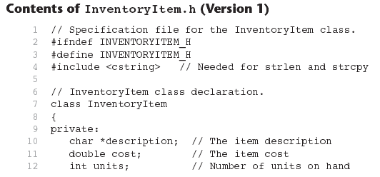
Contents of InventoryItem.h Version1

Slide 59
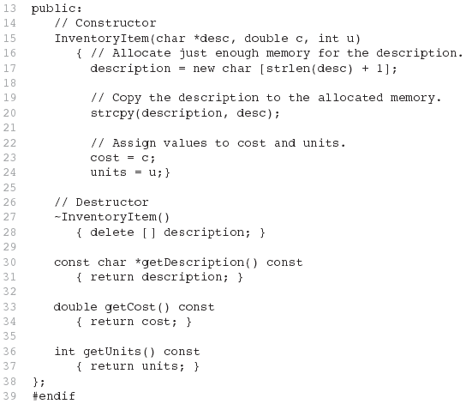
Contents of InventoryItem.h Version1 (Continued)

Slide 60
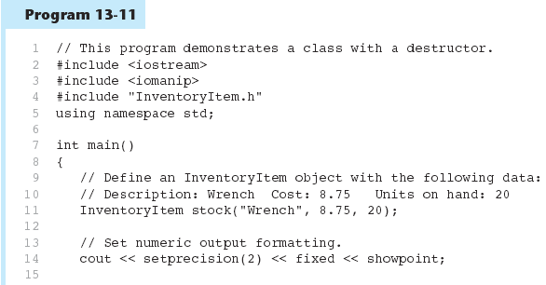
Contents of InventoryItem.h Version1 (Continued)
Program 12-11

Slide 61
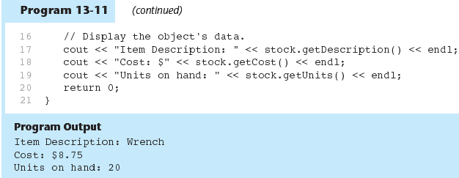
Contents of InventoryItem.h Version1 (Continued)
Program 12-11 Continued

Slide 62
Constructors, Destructors, and Dynamically Allocated Objects
When an object is dynamically allocated with the new operator, its constructor executes:
Rectangle *r = new Rectangle(10, 20);
When the object is destroyed, its destructor executes:
delete r;

Slide 63
Exercise Week 11_10
Refer to Exercise 2 No. 4 in Lab 9 pg. 153-155.
Solve the problem.

Slide 64
Week 11.10
Overloading Constructors

Slide 65
Overloading Constructors
A class can have more than one constructor
Overloaded constructors in a class must have different parameter lists:
  Rectangle();
  Rectangle(double);
  Rectangle(double, double);

Slide 66
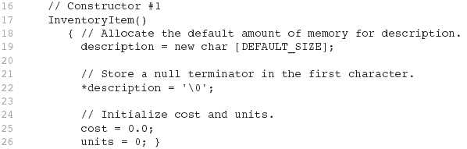
From InventoryItem.h
(Version 2)

Slide 67
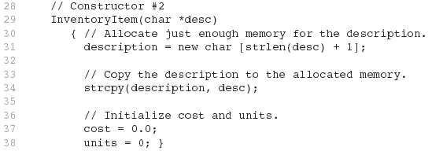
From InventoryItem.h
(Version 2)

Slide 68
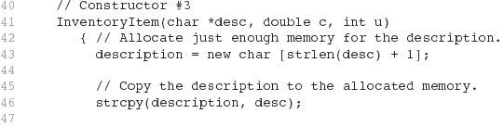

From InventoryItem.h
(Version 2)

Slide 69
Only One Default Constructor and One Destructor
Do not provide more than one default constructor for a class: one that takes no arguments and one that has default arguments for all parameters
  Square();
  Square(int = 0); // will not compile
Since a destructor takes no arguments, there can only be one destructor for a class

Slide 70
Member Function Overloading
Non-constructor member functions can also be overloaded:
  void setCost(double);
  void setCost(char *);
Must have unique parameter lists as for constructors

Slide 71
Example - Member Function Overloading
#include <iostream>
using namespace std;
class Rectangle
{ private: int height, width;
public:
Rectangle(int);
Rectangle(int, int);
int getSide()
{return height;}
int getArea(int);
int getArea(int, int);
};

Slide 72
Example - Member Function Overloading
Rectangle::Rectangle(int x)
{ height=x; width=x;}
Rectangle::Rectangle(int x, int y)
{ height=x; width=y;}
int Rectangle::getArea(int x)
{ return(x*x);}
int Rectangle::getArea(int x, int y)
{ return (x*y);}
int main(){
Rectangle c(5,6);
Rectangle d(6);
cout<<d.getArea(d.getSide())<<endl;
cout<<c.getArea(5,6);
return 0;
}
Constructor
overloading
Function
overloading

Slide 73
Exercise Week 11_11
Refer to Exercise 2 No. 3ii and iii in Lab 9 pg. 152-153.
Solve the problem.

Slide 74
Week 11.11
Using Private Member Functions

Slide 75
Using Private Member Functions
A private member function can only be called by another member function
It is used for internal processing by the class, not for use outside of the class
See the createDescription function in InventoryItem.h (Version 3)

Slide 76
From InventoryItem.h
class InventoryItem
{
private:
char *description; // The item description
double cost; // The item cost
int units; // Number of units on hand
void createDescription(int size, char *value) {
description = new char [size];
strcpy(description, value); }
public:
:
:
void setDescription(char *d)
{ strcpy(description, d); }
:
:
};

Slide 77
Week 11.12
Arrays of Objects

Slide 78
Arrays of Objects
class InventoryItem {
private:
char *description; double cost; int units;
public:
InventoryItem();
InventoryItem(const char desc[]);
InventoryItem(const char desc[],double c, int u);
~InventoryItem();
:
}; // end of class declaration
Objects can be the elements of an array:
InventoryItem inventory[40];
Default constructor for object is used when array is defined

Slide 79
Arrays of Objects
Must use initializer list to invoke constructor that takes arguments:
  InventoryItem inventory[3] =
  { "Hammer", "Wrench", "Pliers" };

Slide 80

Arrays of Objects
If the constructor requires more than one argument, the initializer must take the form of a function call:

Slide 81

Arrays of Objects
It isn't necessary to call the same constructor for each object in an array:

Slide 82
Accessing Objects in an Array
Objects in an array are referenced using subscripts
Member functions are referenced using dot notation:
  inventory[2].setUnits(30);
  cout << inventory[2].getUnits();

Slide 83
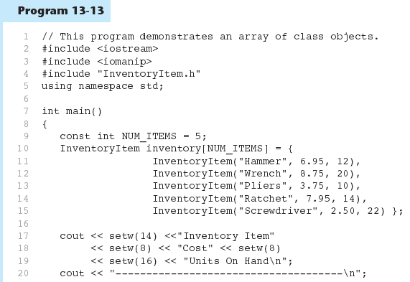
Example -Accessing Objects in an Array
Program 12-13

Slide 84
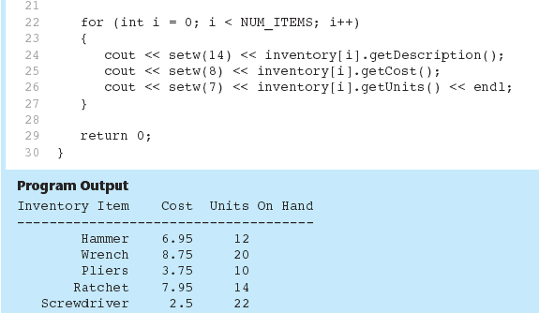
Example -Accessing Objects in an Array
Program 12-3 (Continued)

Slide 85
Exercise Week 11_12
Refer to Exercise 2 No. 3iv in Lab 9 pg. 153.
Declare a pointer to access the array and change statements 7-9 to use pointer variable.

Slide 86
Week 11
Passing Objects to Function

Slide 87
Passing Objects to Functions
Can pass an object to a function in 3 ways:
  Pass-by-value
  Pass-by-reference
  Pass-by-reference via pointer

Slide 88
Pass-By-Value Example
#include <iostream>
using namespace std;
class Circle
{ private: double radius;
public:
Circle(double r){radius=r;}
double getRadius(){return radius;}
double getArea(){return radius*radius*3.14;}
};
void printCircle(Circle a)
{ cout<<a.getRadius()<<" "<<a.getArea();}
int main()
{ Circle ab(5.5);
printCircle(ab);
return 0;
}

Slide 89
Pass-By-Reference
#include <iostream>
using namespace std;
class Circle
{ private: double radius;
public:
Circle(double r){radius=r;}
double getRadius(){return radius;}
double getArea(){return radius*radius*3.14;}
};
void printCircle(Circle &a)
{ cout<<a.getRadius()<<" "<<a.getArea();}
int main()
{ Circle ab(5.5);
printCircle(ab);
return 0;
}

Slide 90
Pass-By-Reference via Pointer
#include <iostream>
using namespace std;
class Circle
{ private: double radius;
public:
Circle(double r){radius=r;}
double getRadius(){return radius;}
double getArea(){return radius*radius*3.14;}
};
void printCircle(Circle *a)
{ cout<<a->getRadius()<<" "<<a->getArea();}
int main()
{ Circle ab(5.5);
printCircle(&ab);
return 0;
}

Slide 91
Exercise Week 11_13
Given the 3 next 3 programs.
Identify the output & discuss the passing objects of the programs.

Slide 92
Exercise Week 11_13
Program 1
class Count
{ public: int num;
Count(int c){num = c;}
Count(){num=0;}
};
void increment(Count c)
{ c.num++; }
int main()
{ Count myCount;
for(int i=0;i<10;i++)
increment(myCount);
cout<<myCount.num;
return 0;
}

Slide 93
Exercise Week 11_13
Program 2
class Count
{ public: int num;
Count(int c){num = c;}
Count(){num=0;}
};
void increment(Count &c)
{ c.num++; }
int main()
{ Count myCount;
for(int i=0;i<10;i++)
increment(myCount);
cout<<myCount.num;
return 0;
}

Slide 94
Exercise Week 11_13
Program 3
class Count
{ public: int num;
Count(int c){num = c;}
Count(){num=0;}
};
void increment(Count *c)
{ c->num++; }
int main()
{ Count myCount;
for(int i=0;i<10;i++)
increment(&myCount);
cout<<myCount.num;
return 0;
}

Slide 95
Week 11.15
The Unified Modeling Language

Slide 96
The Unified Modeling Language
UML stands for Unified Modeling Language.
The UML provides a set of standard diagrams for graphically depicting object-oriented systems

Slide 97
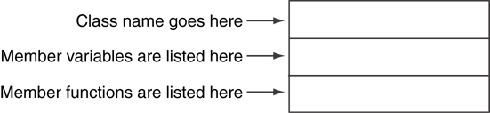
UML Class Diagram
A UML diagram for a class has three main sections.

Slide 98
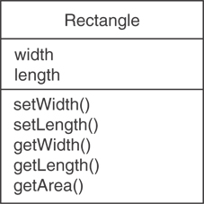
Example: A Rectangle Class
class Rectangle
{
private:
double width;
double length;
public:
bool setWidth(double);
bool setLength(double);
double getWidth() const;
double getLength() const;
double getArea() const;
};

Slide 99
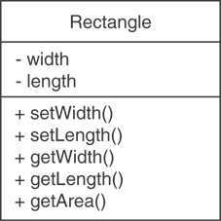
UML Access Specification Notation
In UML you indicate a private member with a minus (-) and a public member with a plus(+).
These member variables are private.
These member functions are public.

Slide 100
UML Data Type Notation
To indicate the data type of a member variable, place a colon followed by the name of the data type after the name of the variable.
- width : double
- length : double

Slide 101
UML Parameter Type Notation
To indicate the data type of a function’s parameter variable, place a colon followed by the name of the data type after the name of the variable.
+ setWidth(w : double)

Slide 102
UML Function Return Type Notation
To indicate the data type of a function’s return value, place a colon followed by the name of the data type after the function’s parameter list.
+ setWidth(w : double) : void

Slide 103
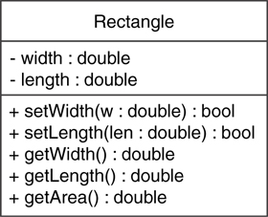
The Rectangle Class

Slide 104
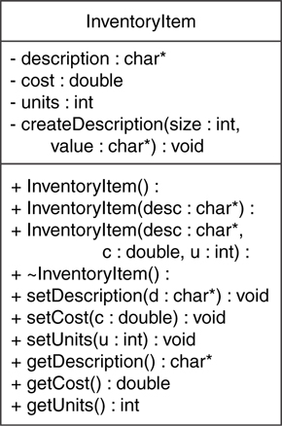
Showing Constructors and Destructors
No return type listed for constructors or destructors
Constructors
Destructor

Slide 105
Lab Exercise Week 11_14
Refer to Exercise 3 No. 3 in page 162-163.
Solve the problem.
Refer to Exercise 3 No. 7 in page 166-167. (Past year question)
Solve the problem.
Submit on 30th April 2014

